Slide 1
Intro to R for Biologists Session 3 Data exploration in depth
Irina & Rao
28/04/2021
Trinity 2021

Slide 2
Intro to R for biologists
Data exploration
Loop functions
Merging
Filtering and logical ops
Intro to Tidyverse
Dplyr verbs – mutate, select, filter, summarise, arrange
Group and summarise data
Reshape data
Analyse Covid data (demo)
Practical (breakout rooms)
Covid data
Wet-lab Covid-vaccine data

Slide 3
Loop functions
lapply() – perform an action on each element of a vector: returns list
sapply() – as above, returns a simplified object (variable)
apply() – loop over rows or columns of a matrix or df
tapply() – loop over a vector, split based on a factor
mapply() – loop over more than one vector
> my_list = list(a = c(1, 2, 3), b = c(4, 5, 6), c = c(7, 8, 9))
> lapply(my_list, mean)
$a
[1] 2
$b
[1] 5
$c
[1] 8

Slide 4
Merging data.frames
gene_symbol
elongatedness
reagent_id
gene_symbol
migration
reagent_id
1
2
3
1
2
3
1
1
df1
2
2
df2
3
3
elongatedness
gene_symbol
reagent_id
migration
merge(df1, df2, by = c(“reagent_id”, “gene_symbol”))

Slide 5
Merging data.frames
gene_symbol
elongatedness
reagent_id
gene_symbol
migration
reagent_id
1
2
3
1
2
3
1
1
df1
2
2
df2
3
elongatedness
gene_symbol
reagent_id
migration
merge(df1, df2, by = c(“reagent_id”, “gene_symbol”), all = FALSE)
# default settings

Slide 6
Merging data.frames
gene_symbol
elongatedness
reagent_id
gene_symbol
migration
reagent_id
1
2
3
1
2
3
1
1
df1
2
2
df2
3
elongatedness
gene_symbol
reagent_id
migration
merge(df1, df2, by = c(“reagent_id”, “gene_symbol”), all = TRUE)
NA

Slide 7
Filtering data
Keep/remove data that satisfies one or more conditions
> my_vec = c(1, 2, 3, 4, 5, 6)
> my_vec < 4
TRUE TRUE TRUE FALSE FALSE FALSE
> my_vec[my_vec < 4]
1 2 3
For more than one condition, we need to use logical operators
& (AND)
| (OR)

Slide 8
Logical operators
TRUE & TRUE # evaluates to TRUE
TRUE & FALSE # evaluates to FALSE
FALSE & FALSE # evaluates to FALSE
TRUE | FALSE # evaluates to TRUE
> my_vec = c(1, 2, 3, 4, 5, 6)
> my_vec < 4 & my_vec > 2
FALSE FALSE TRUE FALSE FALSE FALSE
> my_vec[my_vec < 4 & my_vec > 2]
3

Slide 9
Data exploration and cleaning
Look at the data
head(), tail(), class(), str(), View()
Are the data types correct? If not, convert to appropriate type
as.numeric(), as.character(), as.logical()
Is there any missing data? NA or NaN are missing data
na.omit(), complete.cases()
Is there unnecessary data? Rows or columns you don’t need?
Subset the data
Filter the data
Visualise the data with graphs

Slide 10
A typical workflow
col1
col2
col3
col1
col2
col3
col1
col3
new_col
col1
col3
col1
col3
1
2
3
1
2
3
1
2
1
1.9
1
1.9
1
1.9
1
2
1
2
3
2
2.1
2
2.1
2
2.1
1
2.1
1
2.1
21
3
2.4
3
2.4
3
2.4
2
2.4
2
2.4
24
Add new column
Select columns
df1
Sort
Filter
This can be achieved by using:
Base R – just the functions that come pre-installed in R
External packages – to make the analysis faster, more readable, more intuitive, etc.
The data.table package – speed, conciseness
The dplyr package (Tidyverse) – readability, beginner-friendly
Other packages are available, but more help available online for the popular ones

Slide 11
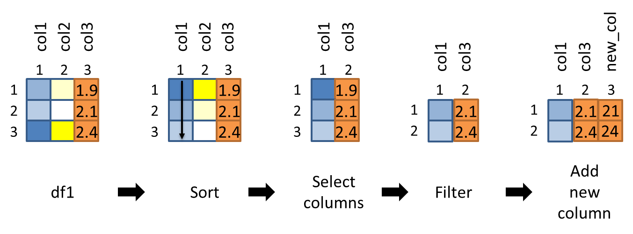
A typical workflow – base R
df1_sorted = df1[order(df1$col1), ]
df1_sel_vars = df1_sorted[, c(“col1”, “col3”)]
df1_filtered = df1_sel_vars[df1_sel_vars$col3 > 2.0, ]
df1_filtered$new_col = df1_filtered$col3 * 10
df1_sort_sel_filtered = df1[order(df1$col1), ][df1$col3 > 2.0, c(“col1”, “col3”)]
df1_sort_sel_filtered$new_col = df1_sort_sel_filtered$col3 * 10

Slide 12
A typical workflow – data.table
df1_sort_sel_filtered = df1[order(col1), ][
col3 > 2.0, .(col1, col3)][
, new_col := col3 * 10]
Install with install.packages(“data.table”)
We won’t discuss data.table in detail, except for some special functions (more from Irina later) but:
More intuitive for some people (similarity to base R)
Ultra-fast reading and writing and sorting (look up fread and fwrite – changed my life!)

Slide 13
A typical workflow – dplyr
df1 %>%
arrange(col1) %>%
select(col1, col3) %>%
filter(col3 > 2.0) %>%
mutate(new_col = col3 * 10) -> df_sort_sel_filtered
* Use spacing and indentation effectively to make your code readable

Slide 14
Dplyr is part of the ‘Tidyverse’
Tabular data structures - one observation per row, one variable per column
Simple functions that do one thing (filter, mutate, arrange, etc.)
Use the ‘pipe’ %>% to chain functions – imagine a flow of data from left to right
The Tidyverse package is a ‘meta-package’ consisting of
dplyr – data manipulation
ggplot2 – plotting (‘Grammar of Graphics’)
tidyr – functions to create ‘tidy data’
readr – reading and writing several file formats
purrr – expanded set of loop functions
tibble – tidy data.frames
stringr – handling strings (joining, searching, splitting, etc.)
forcats – handling categorical data (factors)

Slide 15
Arrange
df1_sorted = arrange(df1, col1)
arrange(df1, col1) -> df1_sorted
OR
OR
df1 %>%
arrange(col1) -> df1_sorted
df1_sorted = arrange(df1, col1, col2)
OR
df1 %>%
arrange(col1, col2) -> df1_sorted

Slide 16
Select columns
df1_selected = select(df1, col1, col3)
OR
df1 %>%
select(col1, col3) -> df1_selected
df1_selected = select(df1, -col2)
OR
df1 %>%
select(-col2) -> df1_selected

Slide 17
Filter
df1 %>%
filter(col3 > 2.0) -> df1_filtered
df1 %>%
filter(col2 < 100 & col3 > 2.0) -> df1_filtered
df1 %>%
filter(col2 < 100 | col3 > 2.0) -> df1_filtered

Slide 18
Mutate
df1 %>%
mutate(new_col = col3 * 2.0) -> df1_mutated
df1 %>%
mutate(new_col = col3 * 2.0) %>%
mutate(col4 = new_col/col3) -> df1_mutated
df1 %>%
mutate(new_col = col3 * 2.0, col4 = new_col/col3) -> df1_mutated

Slide 19
Base R vs Dplyr syntax
Column names in quotations in base R, but not in Dplyr
Df1[, “col1”] # base R syntax
select(df1, col1) # dplyr syntax
Dplyr functions always have the data as the first argument
select(df1, col1)
arrange(df1, col1)
mutate(df1, col4 = col1 * 10)
When the ‘pipe’ %>% is used, the first argument of any function is passed invisibly, so we drop it in the actual function call
df1 %>% arrange(df1, col1) %>% select(df1, col1, col3)

Slide 20

Let’s explore practically
Try out the PROBLEM SET in breakout rooms

Slide 21
Summarise
Reduces multiple values to a single value
One column:
summarise(df1, sum(col1)) or summarise(df1, mean(col2))
Several columns:
summarise(df1, sum(col1), mean(col2), sd(col3))
Assign column names:
df1 %>%
summarise(sum_col1 = sum(col1), mean_col2 = mean(col2), sd_col3 = sd(col3)) -> df1_sum
Note: summarise()can be used separately, but typically used on grouped data created by group_by() - see next slides.

Slide 22
Useful functions for summarisation
Center: mean(), median()
Spread: sd(), IQR()
Range: min(), max(), quantile()
Position: first(), last()
Count: n(), n_distinct()
Logical: any(), all() ...

Slide 23
Group by one or more variables
df1 %>% group_by(col2)
Grouping itself doesn’t change how the data looks!
It means that further operations will always be performed “by group”.
df1 %>%
group_by(col2) %>%
summarise(sum_col4 = sum(col4)) -> df1_grouped
df1 %>%
group_by(col2, col3) %>%
summarise(sum_col4 = sum(col4)) -> df1_grouped
df1 %>%
group_by(new_col2 = toupper(col2)) %>%
summarise(sum_col4 = sum(col4)) -> df1_grouped

Slide 24
Explore it yourself
Scoped grouping - three scoped variants:
group_by_all(), group_by_if() and group_by_at() make it easy to group a dataset by a selection of variables.
across() - function, superseding the _all, _at, and _if versions of summarise() and mutate()
df1 %>%
group_by(col2, col3) %>%
summarise(across(c(col1, col4), mean)) -> df1_grouped

Slide 25
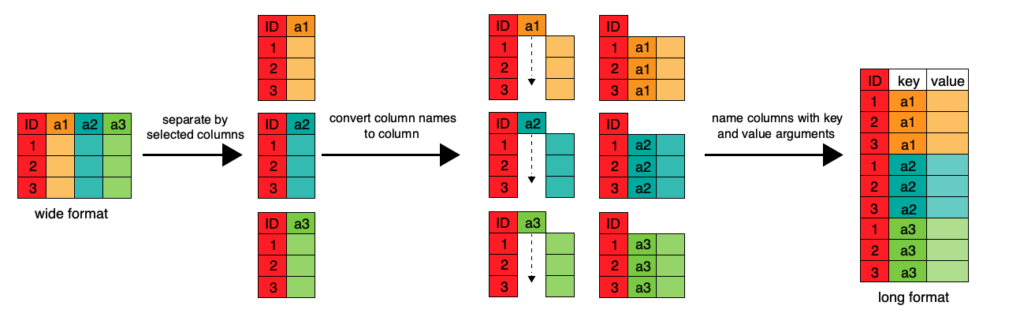
Wide vs. Long data format

Slide 26
Reshaping data with data.table
melt(data,
id.vars,
measure.vars,
variable.name = "variable", value.name = "value",…)
Wide-to-long format
dcast(data,
formula,
value.var = guess(data),…)
Long-to-wide format
Hint: tidyr – part of Tidyverse (introduced by Rao) has synonymous reshaping functions gather and spread

Slide 27
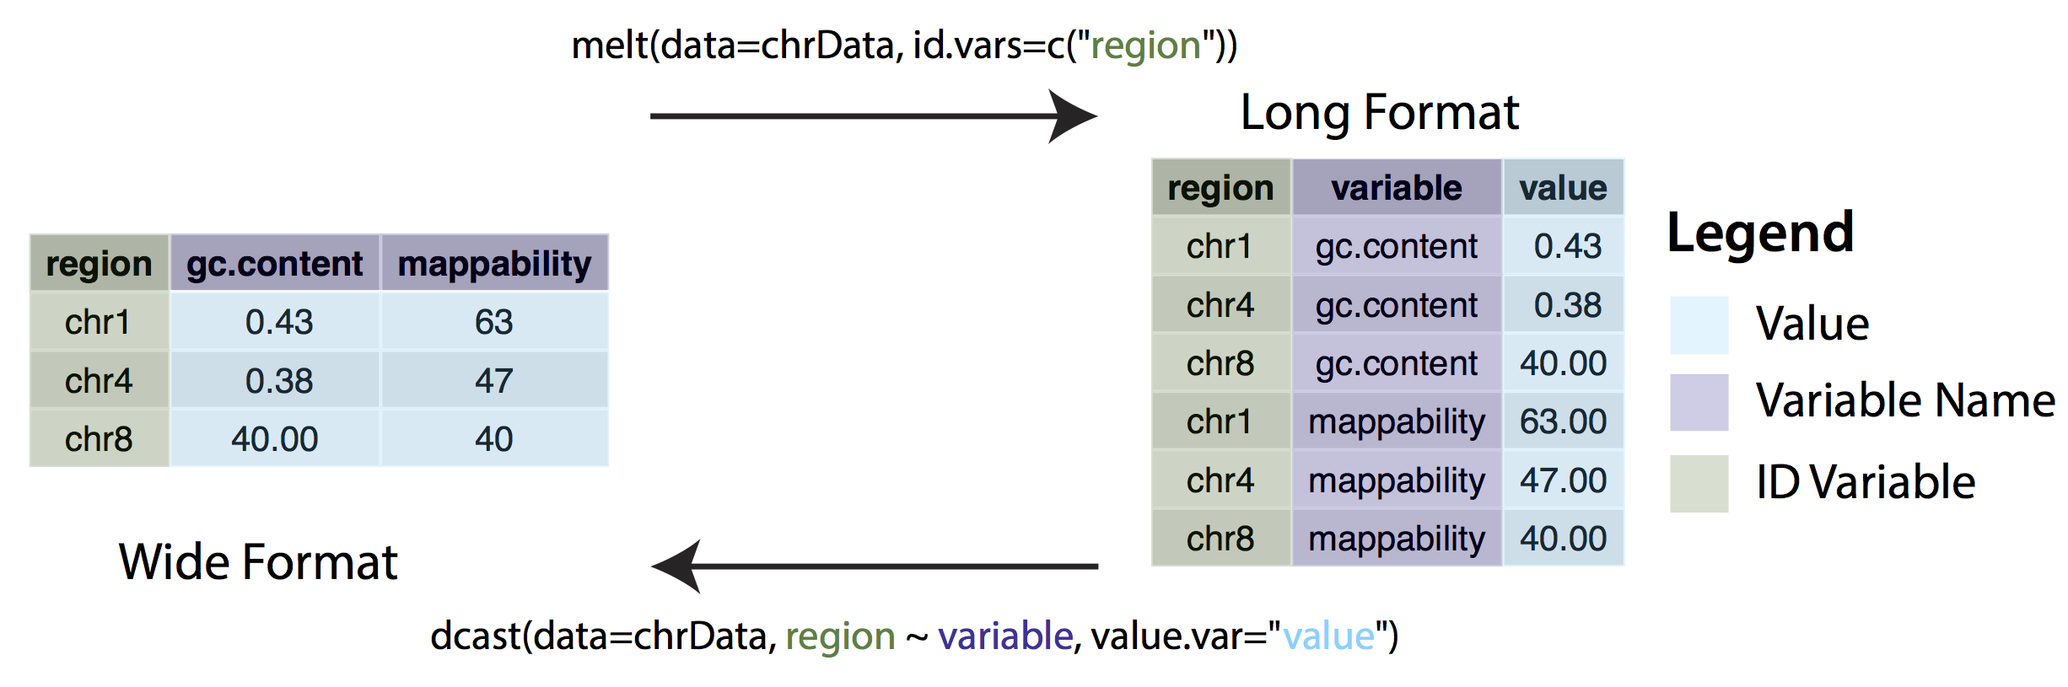
Reshaping data - example

Slide 28

Real dataset
DOI: 10.1038/s41591-020-01194-5

Slide 29
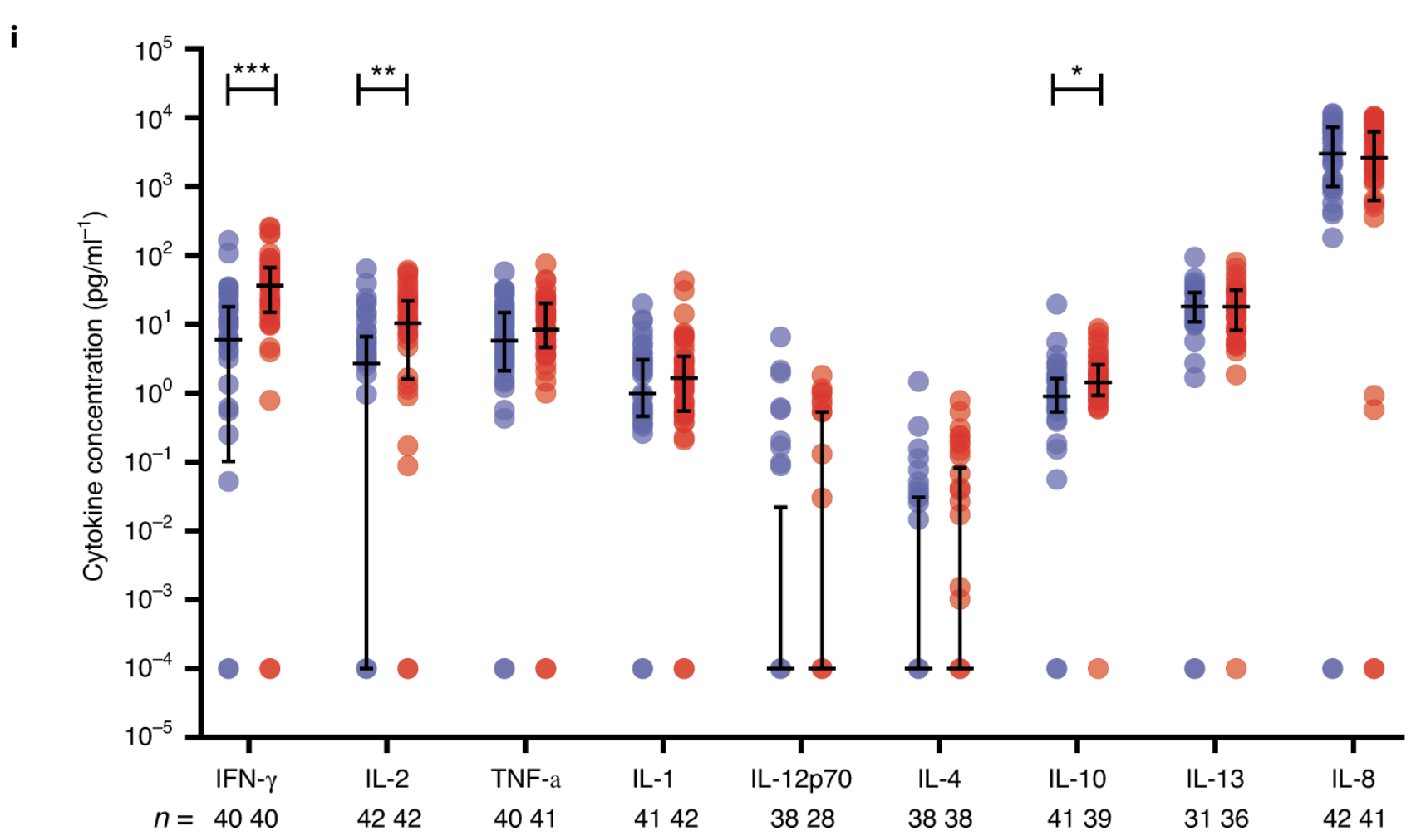
Data to explore - MSD
Fig.1
A multiplex cytokine analysis was performed on day 7 after vaccination using supernatants after antigen-specific stimulation of PBMCs from ChAdOx1 nCov-19 (red) and MenACWY (blue). Number of samples presented: MenACWY–ChAdOx1 nCov-19: IFN-γ (n = 40,40); IL-2 (n = 42,42); TNF-α (n = 40,41); IL-1β (n = 41,42); IL-12p70 (n = 38,28); IL-4 (n = 38,38); IL-10 (n = 41,39); IL-13 (n = 31,36); and IL-8 (n = 42,41). Individual data points are shown here as an aligned dot plot with lines showing the median with IQR. Significant differences were determined by two-tailed Mann–Whitney test with Bonferroni correction for multiple comparisons (***P < 0.001; **P < 0.01; *P < 0.05).

Slide 30
Let’s explore practically
Address the tasks in breakout rooms!

Slide 31
Useful reference
R Programming for Data Science (Roger Peng) – Ch. 3, 4, 5, 9
Swirl – Interactive learning
R for Data Science (Hadley Wickham) – Using Dplyr verbs
The data.table package – Intro
A data.table and Dplyr tour – Side by side comparison of functions
Cheatsheets – quick reference for tasks like data wrangling, visualisation, and several packages

